Slide 1
THIS IS A POWER-BI DASHBOARD THAT COVERS A ESSENTIAL OFFICE SUPPLIER’s SALES ANALYSIS THROUGH POWER-BI DAX..
DESIGNED & ANALYSED BY
TANJU GOGOI

Slide 2
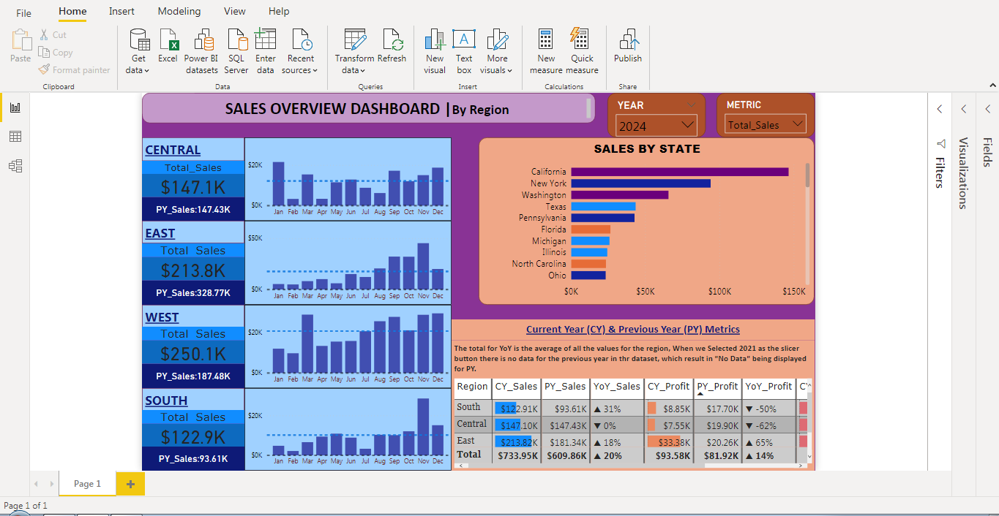

Slide 3
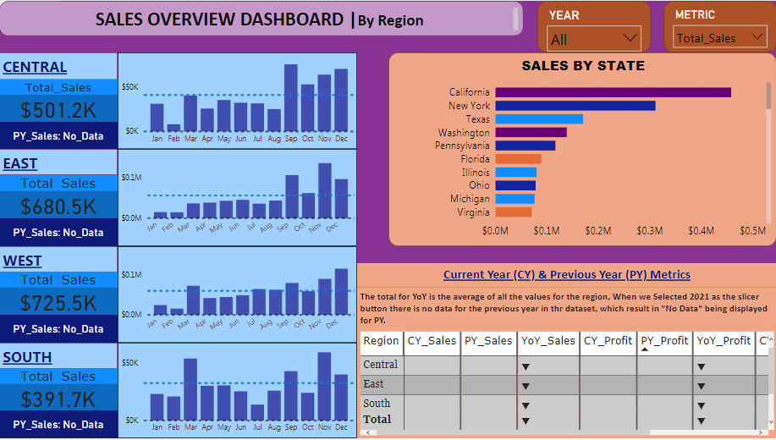
Showing full detailed dashboard by selecting All years, Total_Sales..

Slide 4
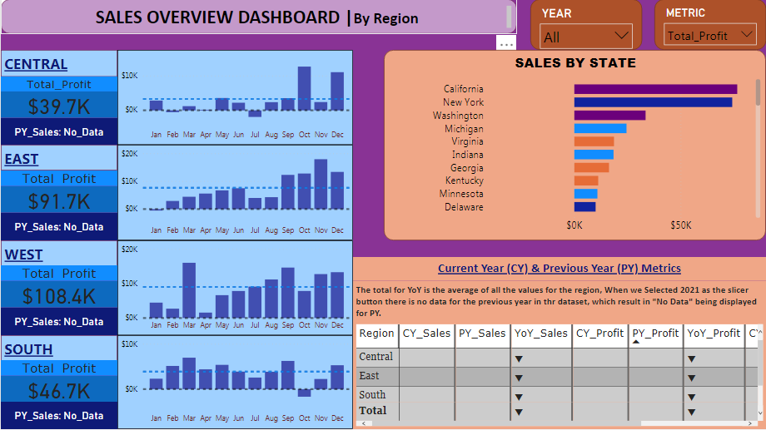
Showing full detailed dashboard by selecting All years, Total_Profit..

Slide 5
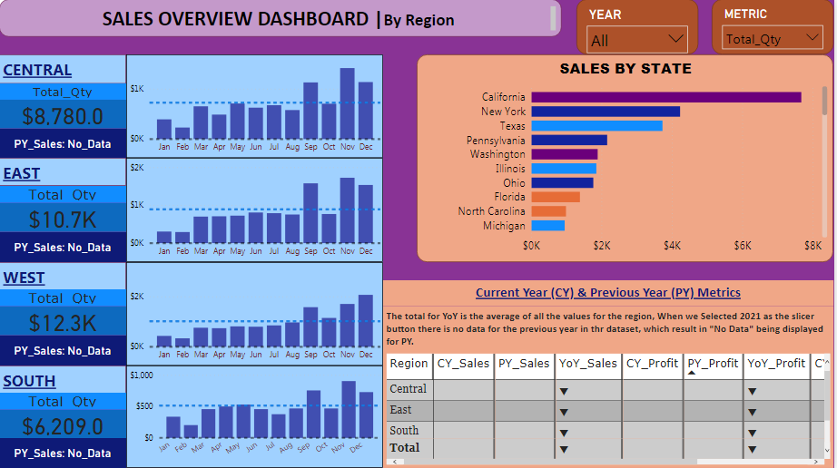
Showing full detailed dashboard by selecting All years, Total_Quantity..

Slide 6
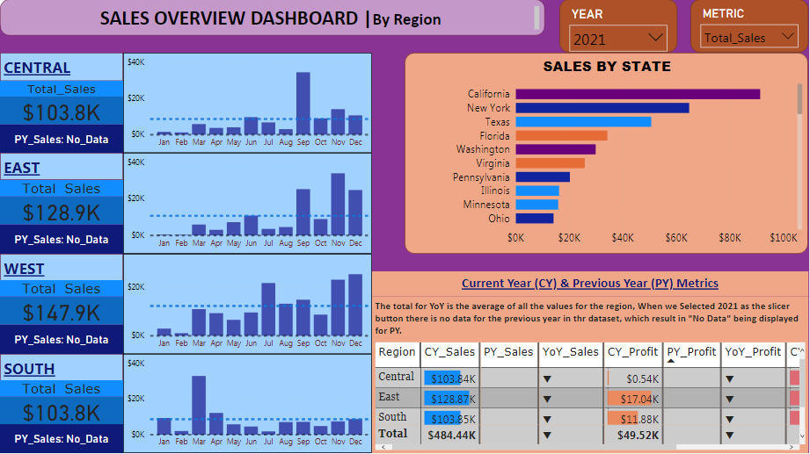
Showing full detailed dashboard by selecting Year:-2021, Total_Sales..

Slide 7
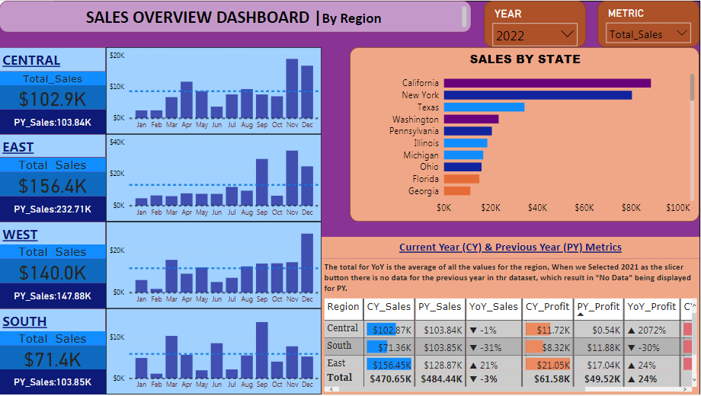
Showing full detailed dashboard by selecting Year:-2022, Total_Sales..

Slide 8
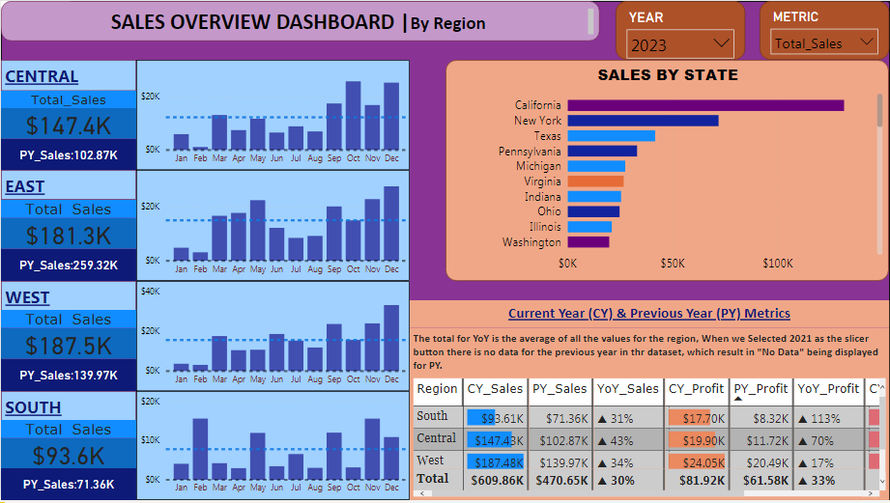
Showing full detailed dashboard by selecting Year:-2023, Total_Sales..

Slide 9
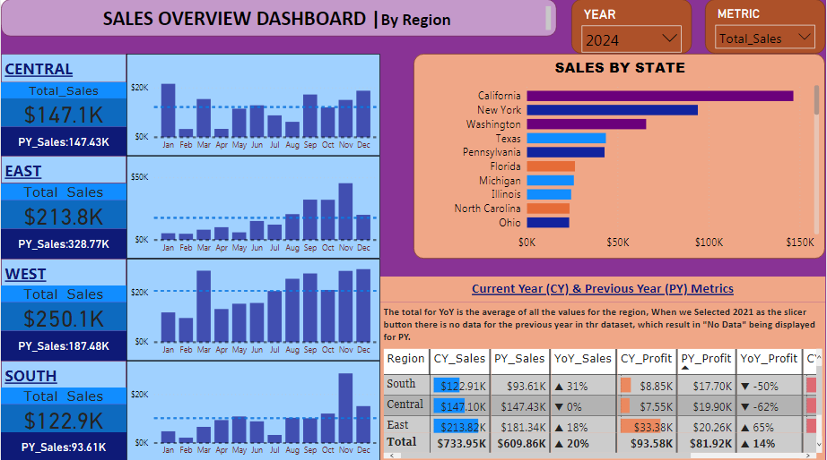
Showing full detailed dashboard by selecting Year:-2024, Total_Sales..

Slide 10
Conclussion:-
It will be quite long to show all details through selecting each year and matric wise, this presentation just an example to show my skills of PowerBI..

